Slide 1
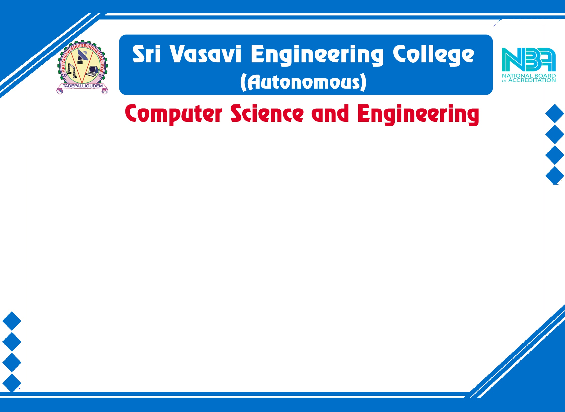

Mini Project External Review
Batch No: 8
Project Title: SMART CANTEEN MANAGEMENT SYSTEM
S .No | Regd.No | Student Name
1 | 21A81A0657 | P. PRANEETHA
2 | 21A81A0612 | G.S.PRABHU KIRAN
3 | 22A85A0605 | P.VASU
4 | 21A81A0649 | N.CHARLES BUNNY
5 | 21A81A0656 | P.VASANTHA
Project Guide:
Dr. K. SRINIVASA RAO

Slide 2

MINI PROJECT REVIEW CONTENTS
Abstract
Introduction
Literature Survey
Problem Statement in Existing System
Proposed System
Objectives
Project domain
Requirement analysis
- Functional Requirements
- Non-Functional Requirements
- Software Requirements
- Hardware Requirements
System Architecture
Methodology

Slide 3
MINI PROJECT REVIEW CONTENTS
Design
Implementation
Result Analysis
Attainment of objective
Conclusion
Future Scope of project
Project Plan

Slide 4
Abstract
The "Smart Canteen Management System" project aims to revolutionize the traditional canteen experience in educational institutions by leveraging modern technologies and automation. This system offers an efficient and convenient approach to managing canteen operations, enabling seamless transactions, improved resource utilization, and enhanced user experience for both faculty members and students. It will bring numerous benefits, including reduced waiting times, increased efficiency, improved inventory management, and enhanced user satisfaction. Every human consumes food atleast 2 – 3 times a day so in that time it can help them without any delay in their schedule. It offers a scalable and adaptable solution that can be tailored to the specific needs of different educational institutions, paving the way for a modern and technologically advanced canteen experience.
.

Slide 5
Introduction
In today's fast-paced educational landscape, where time is of the essence, every facet of campus life seeks innovation to enhance efficiency and convenience. The "Smart Canteen Management System" project emerges as a pioneering solution aimed at revolutionizing the conventional canteen experience within educational institutions.
Traditional canteen setups often grapple with challenges such as lengthy queues, manual processes, and inadequate resource management. These limitations not only inconvenience individuals but also hinder the overall productivity of educational institutions. Recognizing these constraints, the "Smart Canteen Management System" endeavors to redefine the way canteens operate, paving the way for a more efficient, tech-driven, and user-centric experience.
.

Slide 6
Literature Survey
SNO | Authors | Research Paper | Publication | Title | Conclusion
1 | M. Ambika, Saravana Kumar R, Sandhya S Nair, Ranjith Kumar S | International Journal of Innovative Technology and Exploring Engineering (IJITEE) | Blue Eyes Intelligence Engineering & Sciences Publication | Cashless Canteen Management System | The advantage of the use of this system is that the scale or size of the business does no longer make any difference to the system. This platform can be enforced on both small and large-scale businesses... Drawback : No liquid cash in payment options
2 | Suman Chatterjee, Manish Kumar Thakur | International Journal of Engineering Research & Technology (IJERT) ISSN: 2278-0181 | www.ijert.org NCRAEM - 2019 Conference Proceedings | Smart College Management System | This android based project will do the task through the application. It will describes the paper work. The admin, faculty or the student will perform all the task very easily and in more convenience way Drawback : Only limited to android applications

Slide 7
Literature Survey
SNO | Authors | Research Paper | Publication | Title | Conclusion
3 | Ketan Bhekare, Chinmay Karandikar, Ganesh Kamble, Varsha Wangikar | Journal of Emerging Technologies and Innovative Research (JETIR) | 2019 JETIR April 2019, Volume 6, Issue 4 | Smart canteen system | More efficient compare to manually work. Due to online process it saves time.The software application will comfort the customers who regularly order food from canteen. Drawback : No timeslot arrangement
4 | Rupali B. Kale , Ruchika K. Balwade, Vipin B. Gawai | All India Shri Shivaji Memorial Society’s College of Engineering, Pune- 411001, Maharashtra, India | SAMRIDDHI Volume 12, Special Issue 2, 2020 | Online Food Ordering System for College Canteen | The main aim of this paper was to develop an Android app to save the time for those students who are waiting in a long queue for ordering their food also again waiting in another queue to take their delivery. Drawback: This is also limited for android based application and impacts privacy.

Slide 8
Literature Survey
SNO | Authors | Research Paper | Publication | Title | Conclusion
5 | Mr. Ram Krishna Singh , Km. Anjali , Madhavi Tripathi , Ashi Sachan, Antima Gupta | International Journal for Research in Applied Science & Engineering Technology (IJRASET) | Volume 11 Issue V May 2023 | E-Canteen System | The E-Canteen application is designed to help both customer and admin by providing best possible service to the customer and improving sales and attracting more business for admin. Drawback : This also doesn’t provide any time slots for delivery and resulting in waiting queues for delivery again.
6 | Dr. C. Mahiba , Rajashekar , S Dhanush, Santosh Kumar, Sharath Chandra BR5 | International Journal of Research Publication and Reviews | Vol 4, no 6, pp 2276-2279 June 2023 | College E-Canteen Management System | The canteen management team benefits from the elimination of paper usage, negating the need for additional personnel at the billing counter. Drawback : Completely based on smart billing system in according to the view of seller.

Slide 9
Problem Statement in Existing System
Canteen management systems have fallen short in addressing the evolving needs of students and faculty members. Long waiting times, manual processes, inefficient resource utilization, and user experiences have become persistent challenges.
While students and faculty members consume food multiple times a day, the existing canteen setups often disrupt their schedules due to cumbersome ordering, payment, and waiting processes. This inconvenience not only impacts individual efficiency but also undermines the overall campus experience.
The lack of scalability and adaptability prevents campuses from tailoring their canteen operations to their unique environments, leading to suboptimal resource allocation and service delivery according to time slots.
In case of large orders prepaid must be included in order to provide security for sellers because in that case refund or taking back orders will be regarded as a huge loss for seller.
.

Slide 10
Proposed System
The proposed "Smart Canteen Management System" is a comprehensive and innovative solution designed to address the shortcomings of traditional canteen management in educational institutions. By leveraging modern technologies and automation, this system aims to transform the canteen experience into a seamless, efficient, and user-centric process. The core components of the proposed system include:
Digital Ordering and Menu Display
Efficient Order Processing and Payment
Real-time Transaction Tracking
Time Slot Reservation in peak time and Management
Feedback and Ratings System
.

Slide 11
Objectives
1. Streamline Operations: Enhance canteen efficiency by digitalizing ordering, reducing waiting times, and optimizing resource allocation.
2. Personalized Experience: Provide users with tailored menus, real-time updates, and personalized recommendations for a satisfying dining journey.
3. Data-Driven Insights: Generate reports on sales trends and user preferences to inform strategic decisions and continuous improvement.
4. Scalable Solution: Develop an adaptable system that can be customized to suit the specific requirements of diverse educational institutions.
5. Technological Advancement: Leverage modern technologies to create a seamless, secure, and user-centric canteen environment.
.

Slide 12
Project Domain
Food Services and Hospitality Management using Django Python Framework.

Slide 13
Requirement analysis
Technologies used in this project are:
Front-End : HTML, CSS
Back-End :Django using python
Database :PostgreSQL
Software requirements:
Local Server: XAMPP
Database : PostgreSQL
Language : PHP
Text Editor : Sublime/ VS Code
Hardware requirements (Minimum):
Processor : Intel Celeron or higher
RAM : 4GB or higher
OS : Windows 7 or higher

Slide 14
Functional requirements -
1)Registration and login
Enable a new user to register to the system.
Authenticate and allow user to login on the web app(through institutional details).
2)Menu and Ordering System
Enable the customers to go through menu and place the order.
Enable him/her to edit his choices before proceeding to place the order.
3) Payment System
Display the payment bill to the customer.
Enable the customer to pay for the placed order through Google Pay or Paytm …(using QR codes). and also enable the system to notify the admin of the successful transaction.
4) Feedback System
Enable a user to submit a Feedback on the CMS , which contains detailed explanation to his/her problem if any just like feedback.

Slide 15
Non functional requirements -
The website shall accommodate 150-200 users during the peak usage time.
Session duration must be of 5 minutes.
Order details must be sent to the customer with in 3 minutes after confirmation.
The system shall display confirmation messages to users within 10seconds after the user submits information to the system.
Responses to queries shall take no longer than 30 seconds to load onto the screen after the user submits the query.

Slide 16
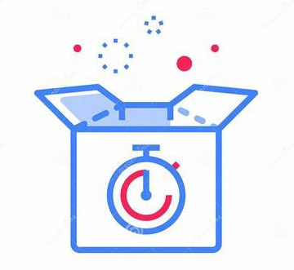

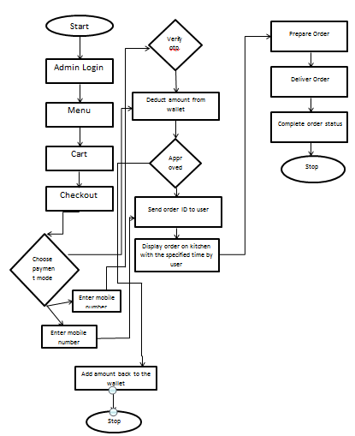


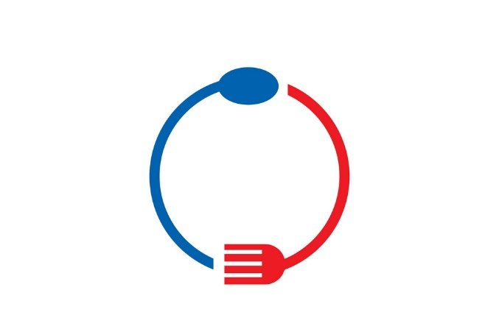


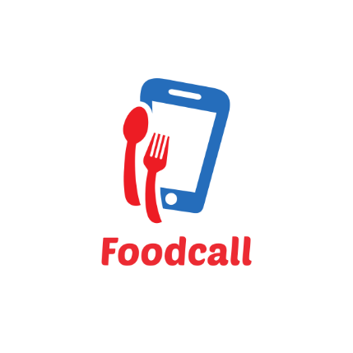


System Architecture
Rating and feedback
Time slot for delivery in peak time
Enrollment of student/staff or any guests
Canteen Management system
Bill
generation
Refer
menu
Receives an authentication SMS
Purchase meals and other foods
Payment options

Slide 17
For a "Smart Canteen Management System" project, an Agile methodology, specifically Scrum, is likely a suitable choice.
Agile Scrum Methodology:
Overview: Scrum is an Agile framework that emphasizes iterative development, collaboration, and flexibility. It breaks the project into smaller time-bound iterations called "sprints," typically lasting 2 to 4 weeks, during which a set of features is developed and delivered.
Benefits:
Iterative Development
Quick Deliveries
Adaptation
Methodology

Slide 18
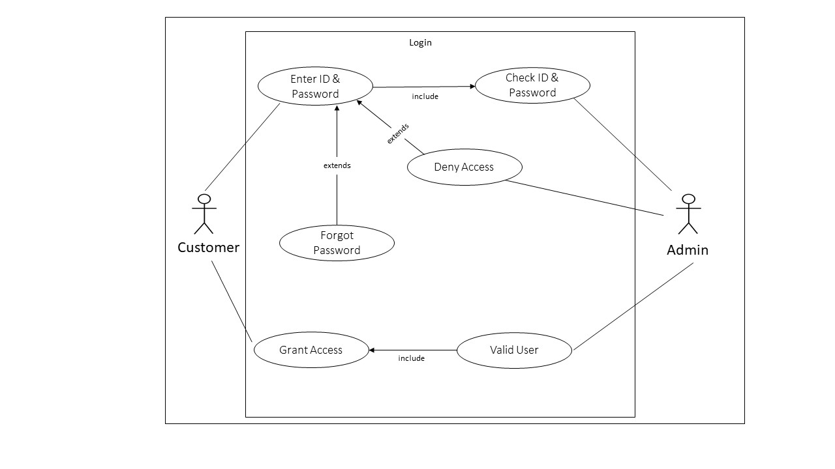
Design Usecase Diagram
Usecase - login

Slide 19
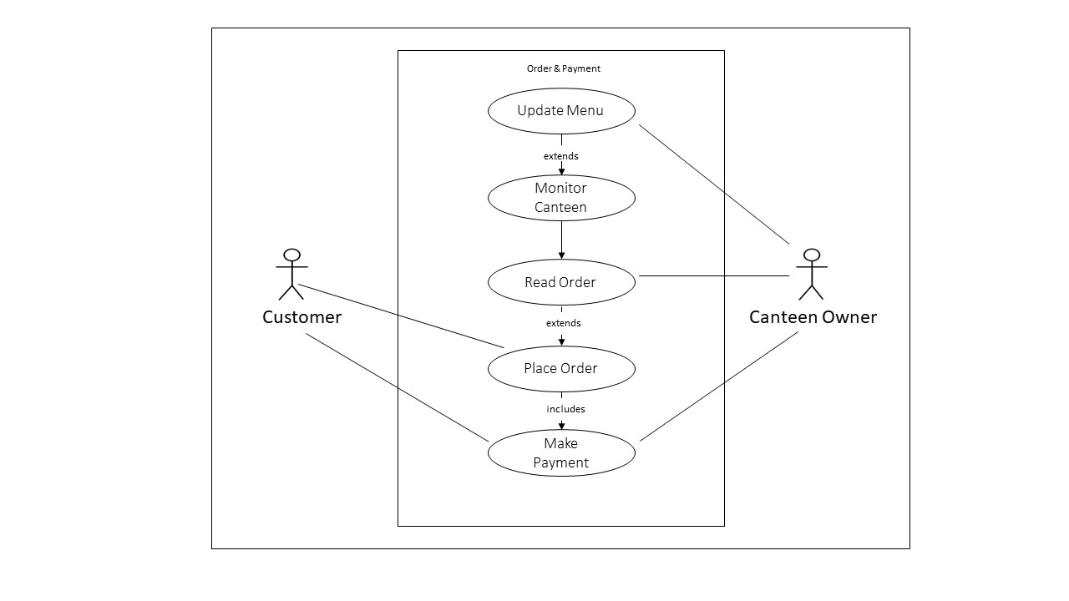
Usecase for order and payment

Slide 20
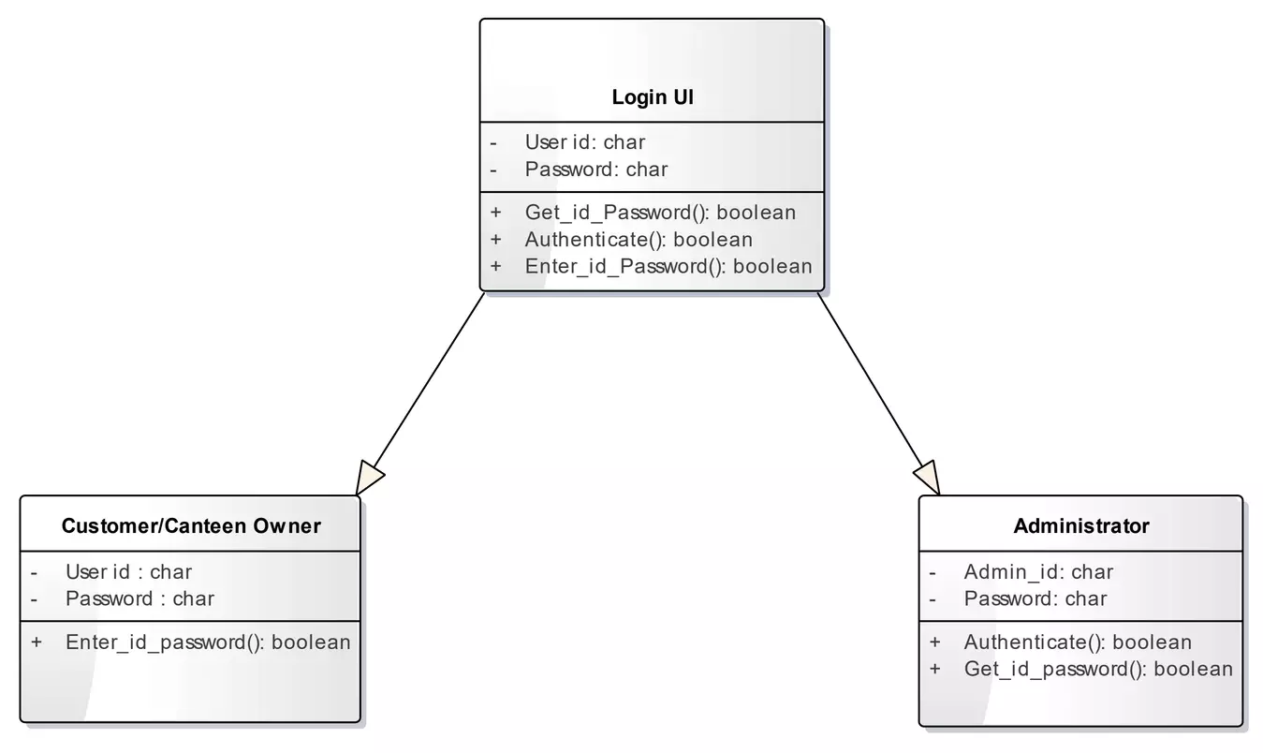
Class Diagrams
Class Diagram - Login

Slide 21
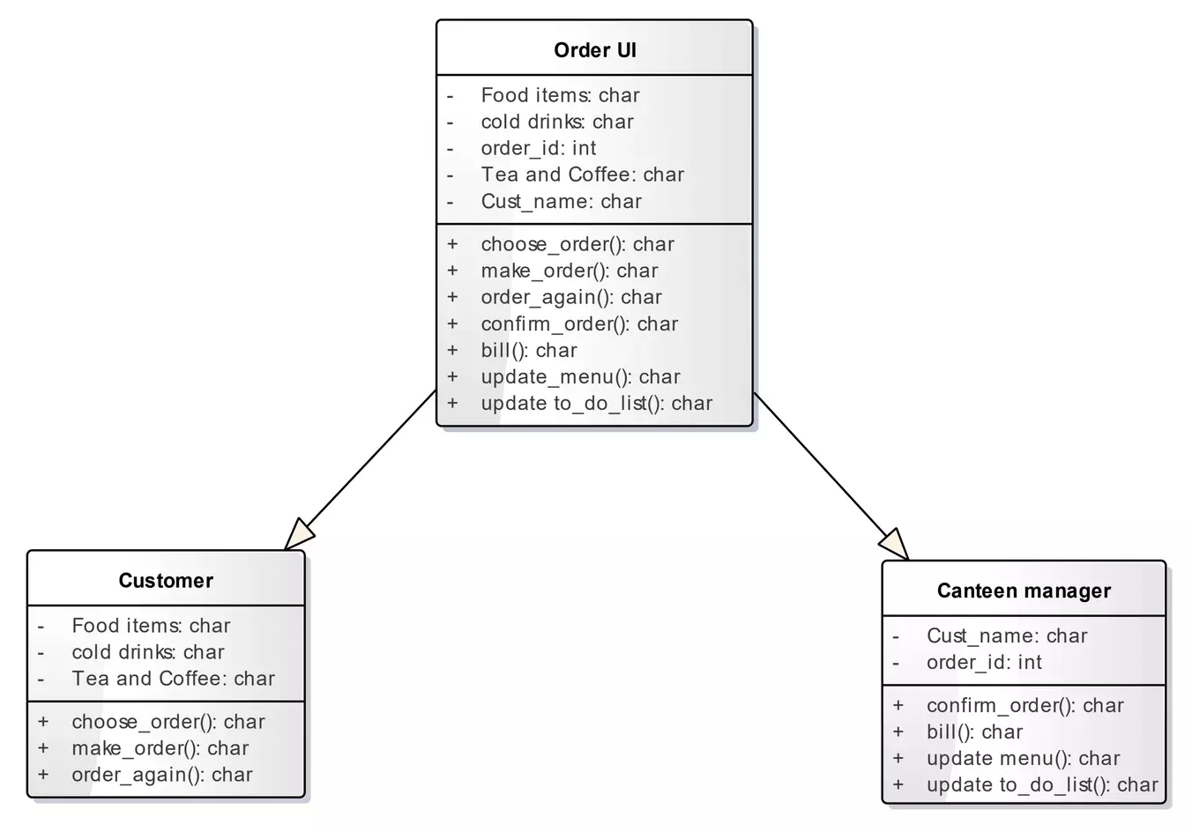
Class Diagram – Order and Update

Slide 22
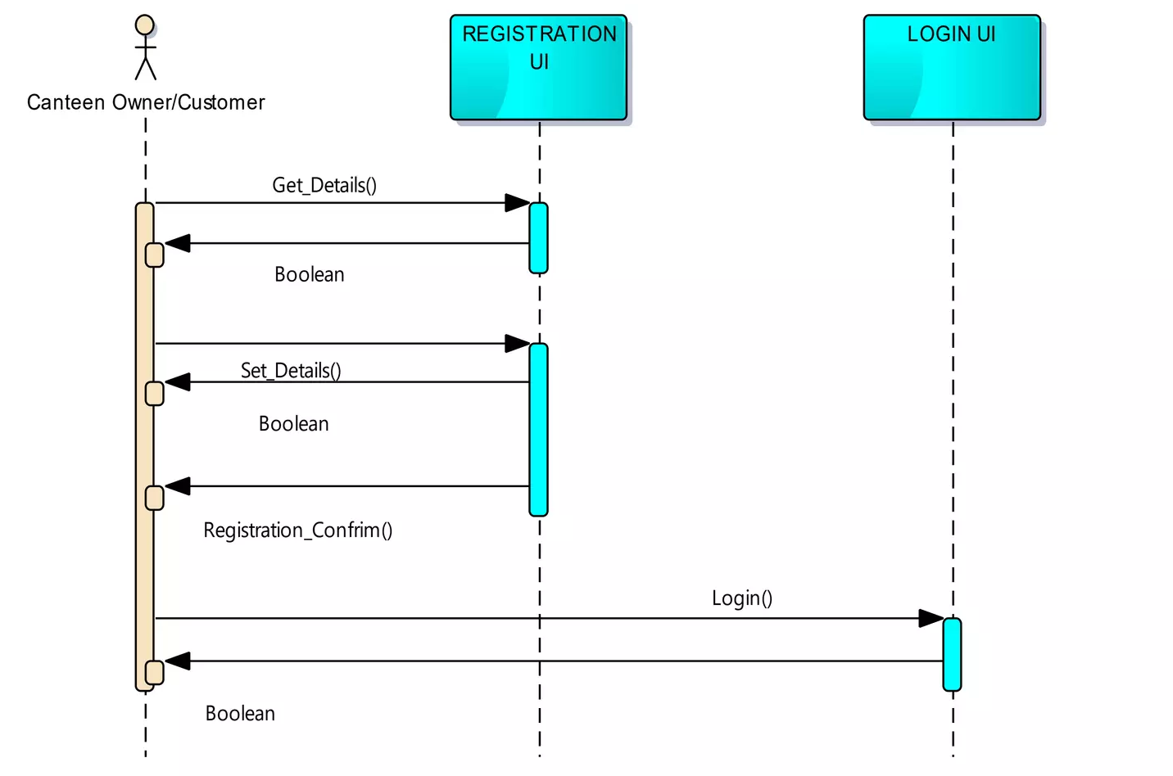
Sequence Diagram
Sequence diagram –Login side

Slide 23
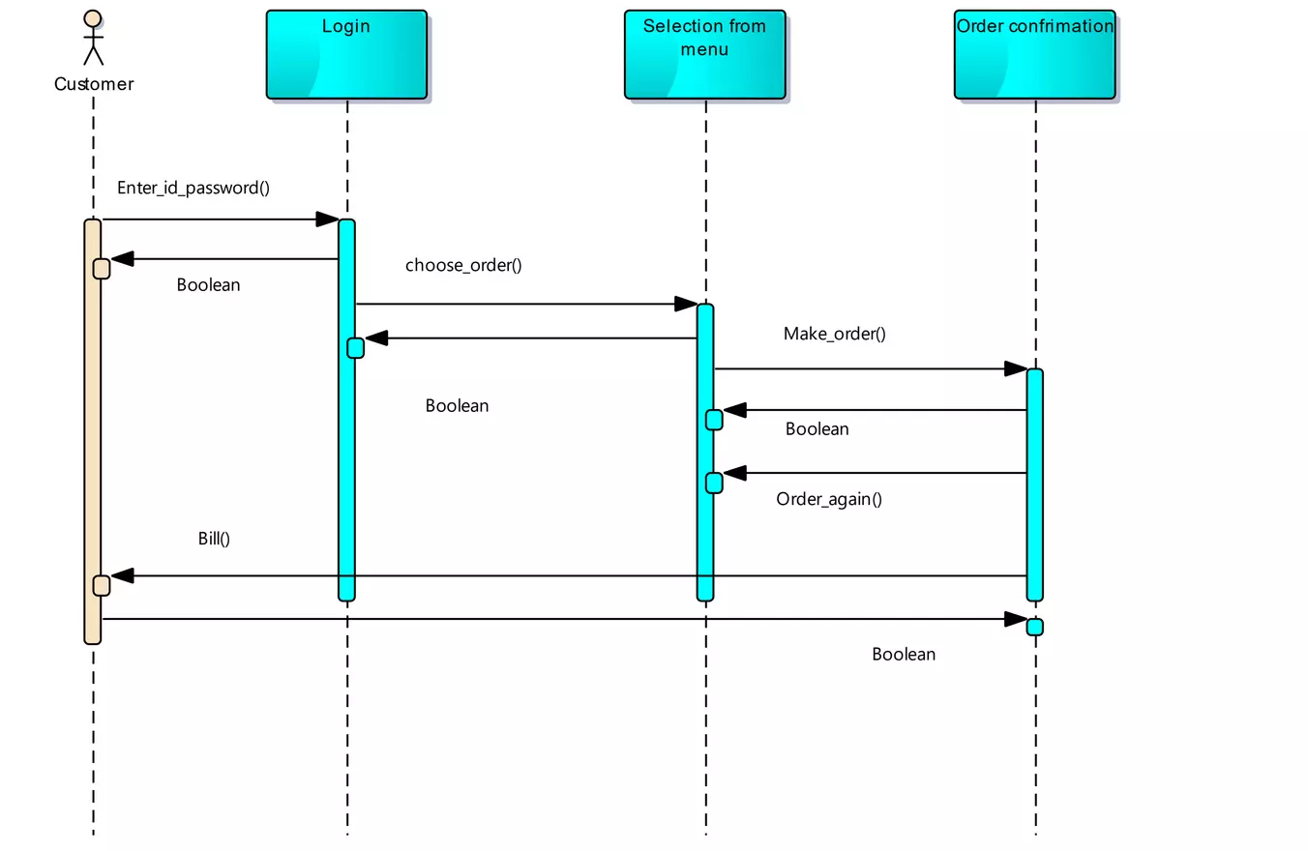
Sequence diagram of placing order

Slide 24
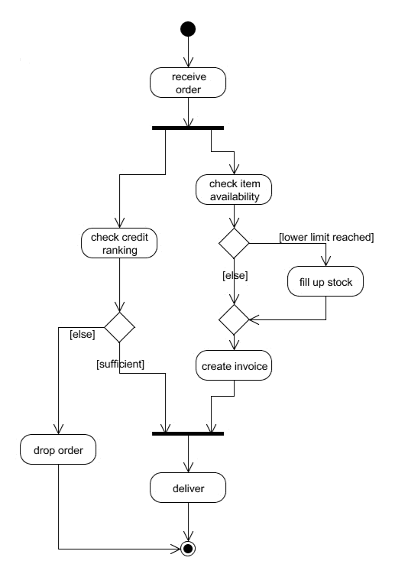
Activity Diagrams
Activity Diagram – Admin side

Slide 25
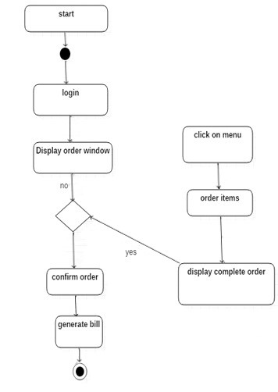
Activity Diagram – Login

Slide 26
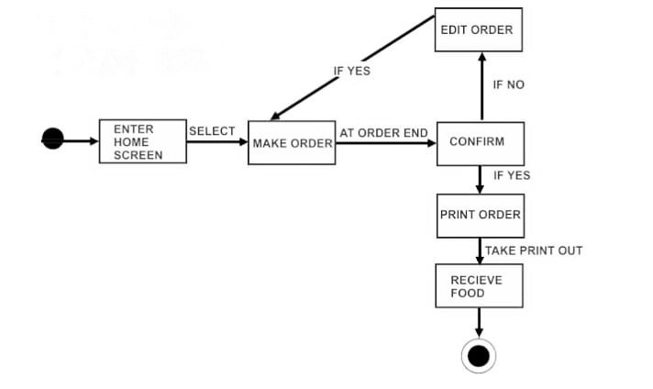
State Diagram

Slide 27
Implementation
1. Canteen Management Module:
This module is responsible for managing canteen details, such as opening hours, location, and contact information.
It includes a menu management system to add, edit, and update food and beverage items available in the canteen.
Functionality for setting pricing and discounts should be included.
2. Sales Module:
This module records and manages sales transactions.
It enables canteen staff to input orders, process payments, and generate invoices or receipts.
Sales data can be tracked for reporting and analysis.
3. Customer Module:
This module stores and manages customer information.
Users, including students and faculty, should have profiles with details like name, ID, and contact information.
It can also include a loyalty program for rewarding frequent customers.

Slide 28
4. Employee Management Module:
Manages information about canteen staff, including chefs, servers, and managers.
Records employee details, work schedules, and payroll information.
May include access controls for specific staff roles.
5. Item Module:
This module manages the details of food and beverage items available in the canteen.
It includes item descriptions, prices, ingredients, and allergen information.
May allow for categorization of items (e.g., breakfast, lunch, beverages, snacks).
6. Stock Module:
This module is responsible for managing inventory and stock information.
It tracks the quantity of items available, alerts for low stock, and generates purchase orders when necessary.
Helps in reducing food wastage and optimizing stock levels.

Slide 29
7. Login Module:
Manages the authentication and access control for system users.
Provides a secure login system for canteen staff and administrators.
Ensures that only authorized personnel can access sensitive information.
8. Users Module:
Manages the roles and permissions of different users within the system.
Assigns roles (e.g., admin, staff, customer) to control access to various modules.
Allows administrators to add, edit, or remove users from the system.
The successful implementation of these modules results in a comprehensive Canteen Management System that streamlines operations, enhances user experience, and improves the overall efficiency of canteen services in educational institutions.

Slide 30
This code break down step by step can be shown as:
1. `<!DOCTYPE html>`, `<html lang="en">`, and `<head>` section:
- This code snippet sets up the basic structure of an HTML document and specifies that the document is in English.
2. PHP Section:
- `include("connection/connect.php");`: It includes an external PHP file, typically used for establishing a database connection. This file probably contains code for connecting to a database.
- `error_reporting(0);`: This line turns off error reporting, which means that PHP won't display any error messages or notices. It's often used to hide undefined index errors.
- `session_start();`: Starts a PHP session, which can be used to store and manage user data across multiple pages. Sessions are commonly used for user authentication and tracking.
3. `<head>` section (continued):
- Various `<meta>` tags provide information about the document, including character encoding, viewport settings, and a description.
- It links to CSS stylesheets (`bootstrap.min.css`, `font-awesome.min.css`, `animsition.min.css`, `animate.css`, and `style.css`) for styling the web page.

Slide 31
4. `<body>` section:
- It contains the main content of the web page.
5. Header Section:
- A navigation bar (`<nav>`) is created. It includes links to different parts of the website like "Home," "Stalls," "Login," "Sign Up," "Your Orders," and "Logout." The visibility of these links depends on whether the user is logged in (checks the `$_SESSION["user_id"]` variable).
6. Banner Section:
- A hero banner section displays an image background with a search form, a title ("Choose it & Enjoy your meals!"), and a description.
7. Popular Section:
- This section is for displaying popular dishes of the week, but it seems to be commented out (`<!-- ... -->`) since the actual PHP code that fetches and displays the popular dishes is missing.
8. How It Works Section:
- This section provides an explanation of how the ordering process works in three steps. It uses SVG icons and text to describe the steps.
9.Closing tags - The code closes all open HTML tags (`</body>`, `</html>`).

Slide 32
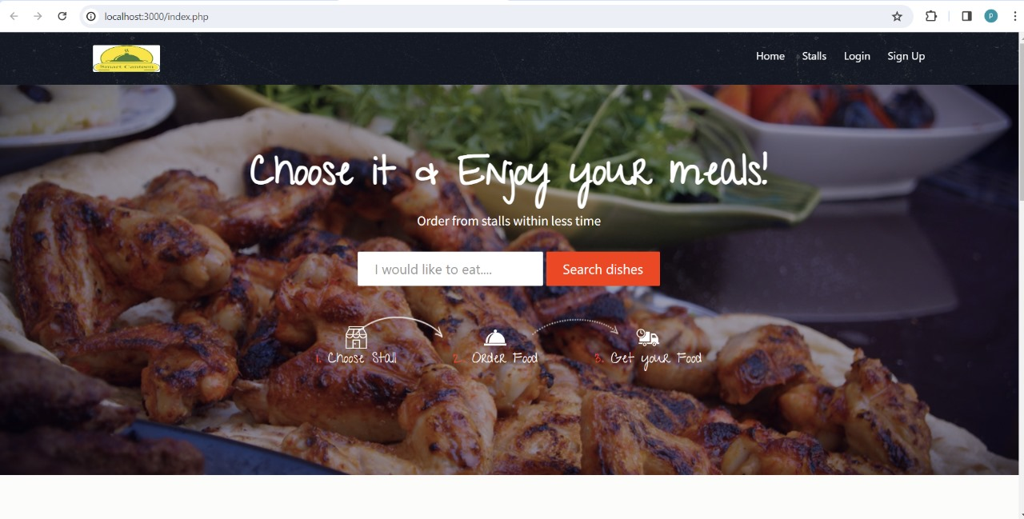
Result Analysis
1.User Interface

Slide 33
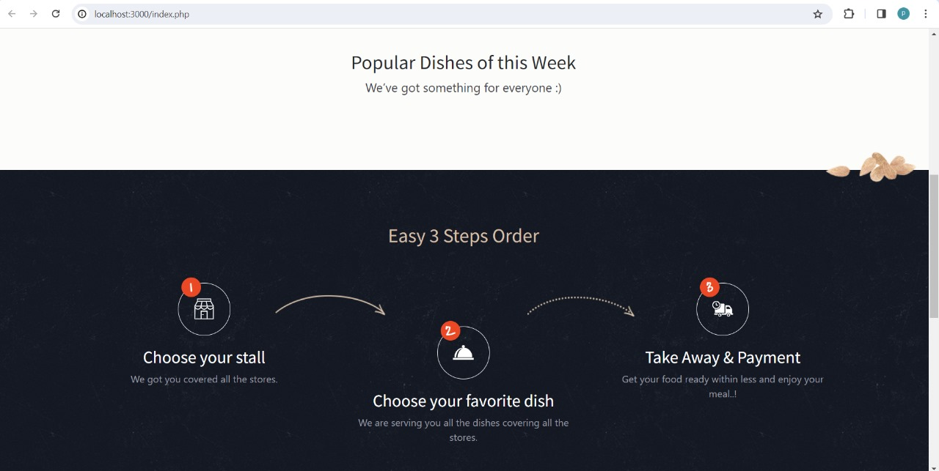

Slide 34
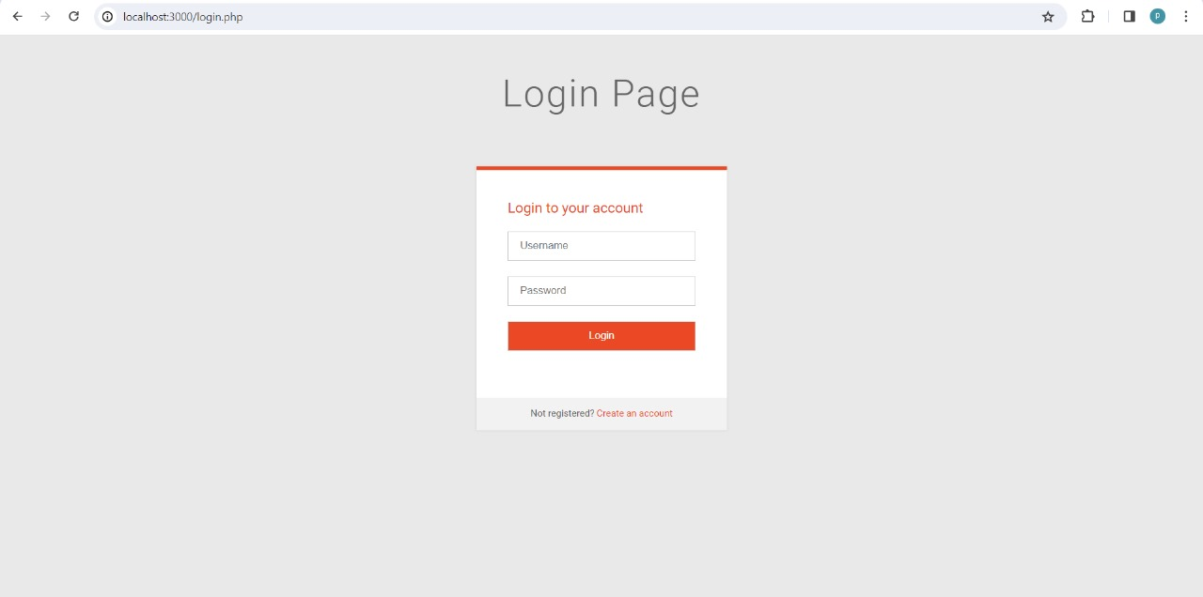
2.Login page

Slide 35
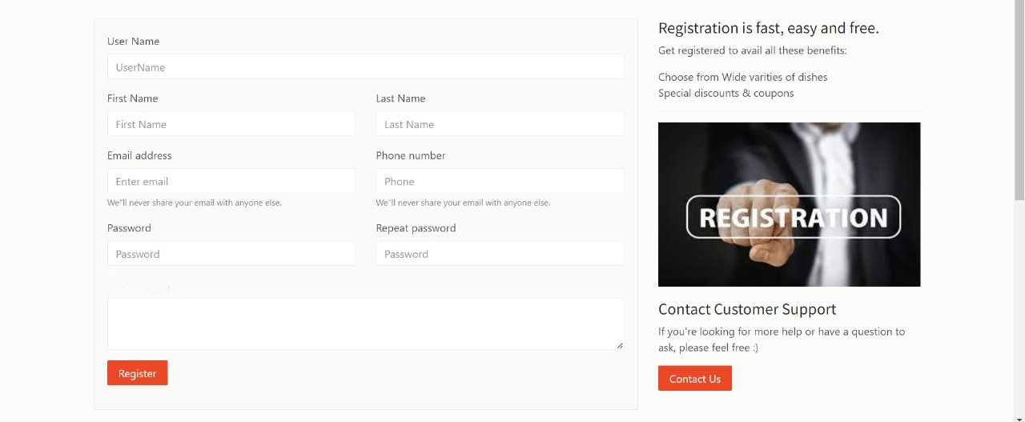
3.Registration page

Slide 36
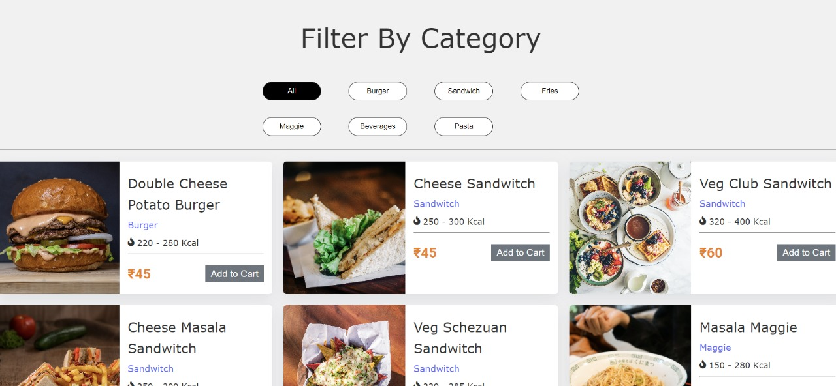
Dishes Interface for User

Slide 37
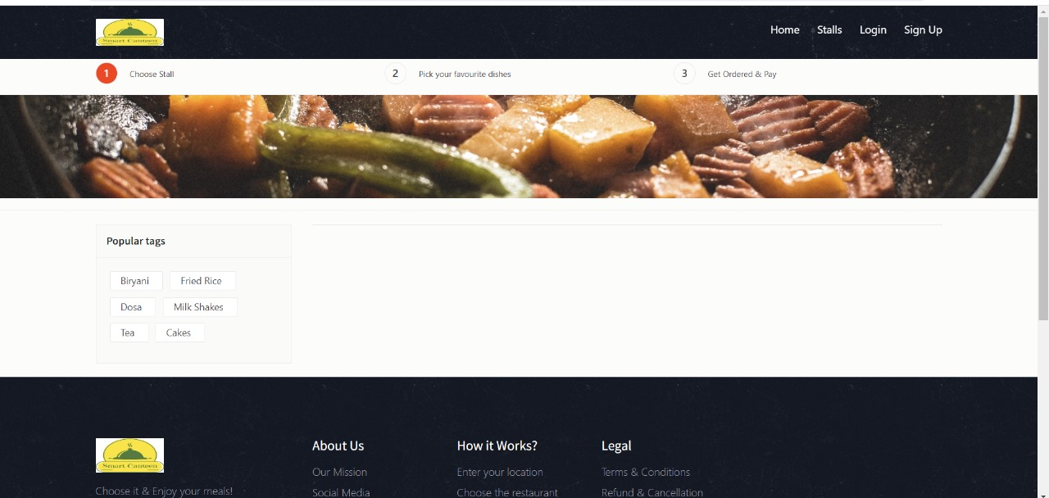
4.Stall Interface for Client

Slide 38
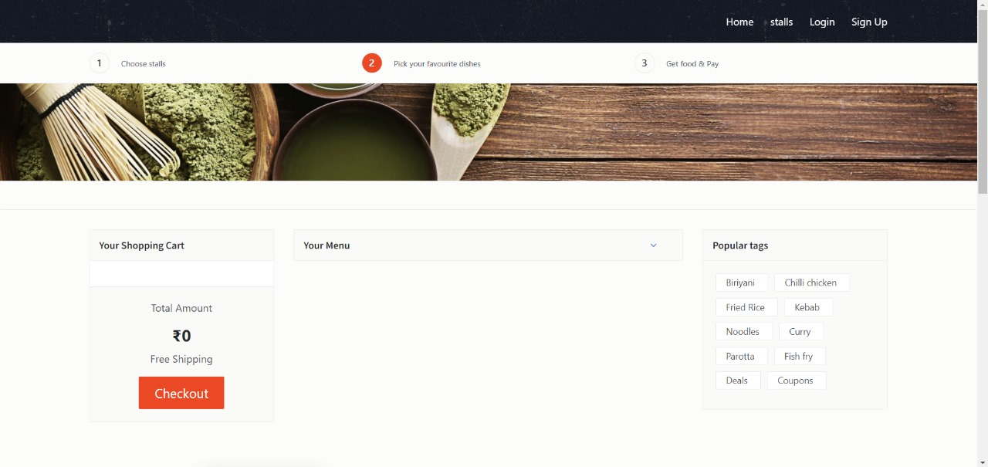

Slide 39
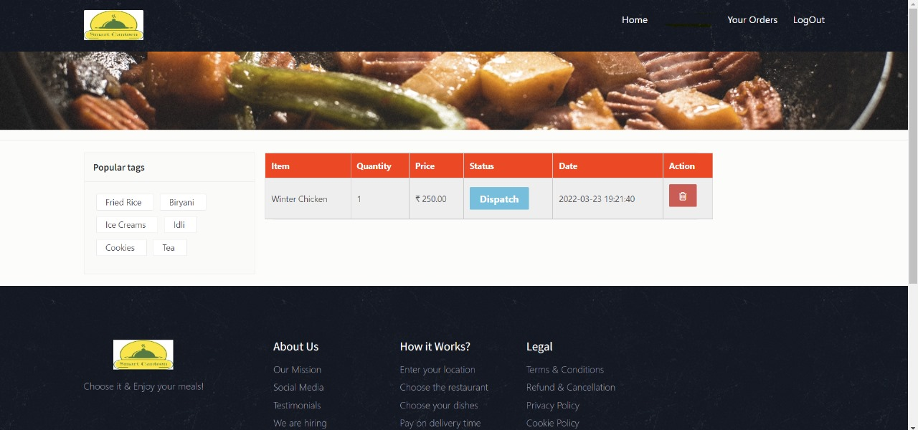
5.Orders Interface for Client

Slide 40
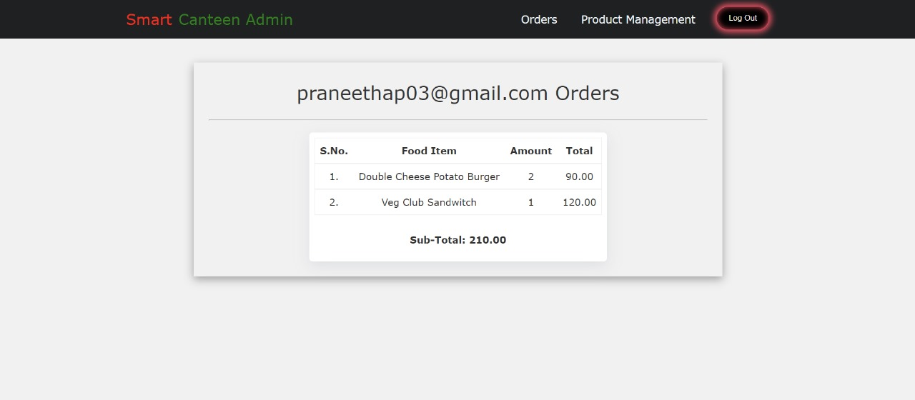
6.Admin Interface

Slide 41
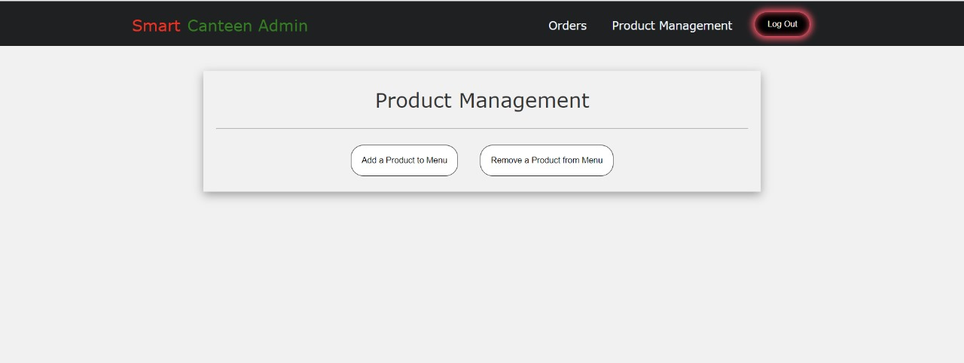
Product management (Admin side)

Slide 42
Attainment of objective
Efficiency and Satisfaction
Swift and efficient canteen transactions.
Enhanced user satisfaction with a high rating.
Reduced waiting times and improved resource utilization.
Operational Improvements
Effective inventory management and minimized food wastage.
Reduced operating costs and improved cost efficiency.
Successful scalability and adaptability to different institutions.
Technological Advancements
Regular system updates to incorporate the latest technology.
Seamless integration with other systems and services.
Robust data security measures and user-friendly system.

Slide 43
Conclusion
Finally, the "Smart Canteen Management System" project seeks to usher in a new era of canteen management in educational institutions by utilizing the strength of contemporary technology and automation. By streamlining transactions, optimizing resource allocation, and boosting the overall experience for both staff members and students, this ground breaking solution presents a practical and user-friendly approach to managing cafeteria operations. Several advantages, including shorter wait times, increased effectiveness, simplified inventory management, and higher user satisfaction, are promised as a result of its implementation. Every person needs many meals a day, thus this method becomes a vital resource for preventing schedule disruptions caused by lengthy lines and delays. Additionally, it provides a flexible and scalable system that enables customization to meet the specific needs of many academic institutions. By doing this, it prepares everyone for a contemporary, cutting-edge, and enjoyable canteen experience.

Slide 44
Future scope of project
We can give more advance software for Canteen Management System including more facilities • We will host the platform on online servers to make it accessible worldwide.
Integrate multiple load balancers to distribute the loads of the system • Create the master and slave database structure to reduce the overload of the database queries .
Implement the backup mechanism for taking backup of codebase and database on regular basis on different servers.
The above mentioned points are the enhancements which can be done to increase the applicability and usage of this project. Here we can maintain the records of Canteen and Employee. Also, as it can be seen that now-a-days the players are versatile, i.e. so there is a scope for introducing a method to maintain the Canteen Management System. Enhancements can be done to maintain all the Canteen, Employee, Item, Stock, Sales.

Slide 45
Project plan
Initiation
Technology Selection
Database Design
Project
discussion
System Design
Developing frontend
Project Plan
Requirement gathering
Integrate and test
Deployment
And project closure

Slide 46

- BATCH - 8

